Slide 1
Math Instructions
© 2015 John Sefcovic

Slide 2
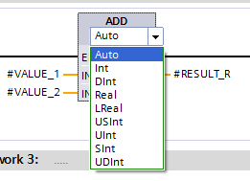

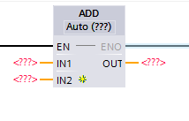
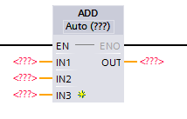
Math
Siemens is picky about data types
32 Bit native PlC Real -> Floating (Scientific notation)
Signed one bit used for sign
The Data Type can be selected from the dropdown.
The Data Type determines how the calculation is performed.
Cannot be neg all 16 bits 65,000 max
For instructions where multiple INs may be used.
Select the Insert in icon.
Datatypes ensure communication between machines.

Slide 3
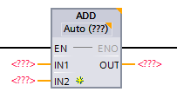
Math
ADD
When rung conditions are true, the ADD output instruction adds IN1 to IN2 and stores the result at the OUT tag. IN1 and IN2 can either tags that contain values or be constant values, however IN1 and IN2 cannot both be constants. The OUT must be an tag.

Slide 4
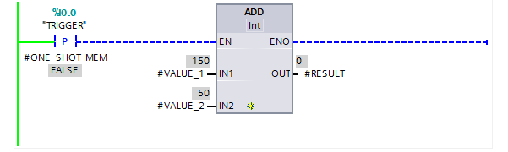
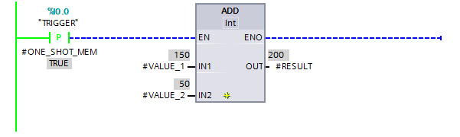
Math
ADD

Slide 5
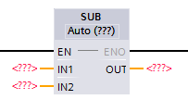
Math
SUBTRACT
When rung conditions are true, the SUB output instruction subtracts IN2 from IN1 and stores the result in the OUT tag. IN1 and IN2 can either tags that contain values or be constant values, however IN1 and IN2 cannot both be constants. The OUT must be an tag.

Slide 6

Math
SUBTRACT

Slide 7
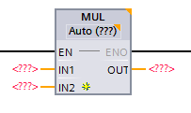
Math
MULTIPLE
When rung conditions are true, the MUL output instruction multiplies IN1 by IN2 and stores the result in the OUT. IN1 and IN2 can either be addresses that contain values or constant values, however IN1 and IN2 cannot both be constants. The OUT must be an address.

Slide 8
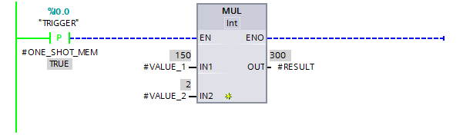
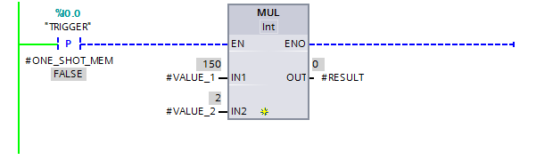
Math
MULTIPLE

Slide 9
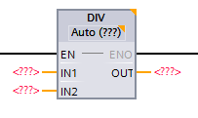
Math
DIVIDE
When rung conditions are true, the DIV output instruction divides IN1 by IN2 and stores the result in the OUT tag. IN1 and IN2 can either tags that contain values or be constant values, however IN1 and IN2 cannot both be constants. The OUT must be an tag.

Slide 10


Math
DIVIDE

Slide 11


Math
When the result will be a real number (with decimal point) and the Instruction and OUT are defined as an Integer, the result is truncated.
DIVIDE

Slide 12
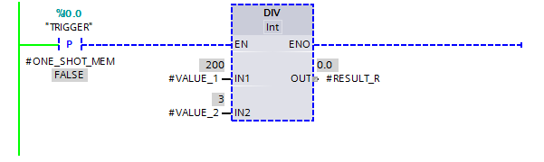
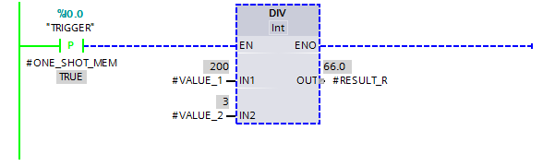
When the result will be a real number (with decimal point) and the Instruction is defined as an Integer, but the Tag for the OUT is defined as a Real…
Math
DIVIDE
…the result is truncated.
The type of Division has been defined by the instruction as Integer, resulting in a truncated
number.
Notice the Implicit Conversion for the Integer result into a Real tag.

Slide 13
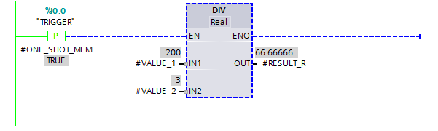
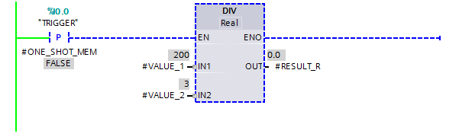
Math
Notice the Implicit Conversion for the Integer tags into Real data.
Defining the Instruction and OUT as Real…
DIVIDE
…the remainder is kept.
Notice the two INs are Integer data types, but the Instruction division type and OUT tag are defined as REAL.

Slide 14
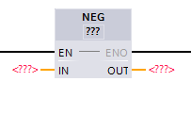
Math
NEGATE
When rung conditions are true, the NEG instruction changes the sign of the IN1nd places it in the OUT. The IN1nd OUT parameters must be tags.

Slide 15
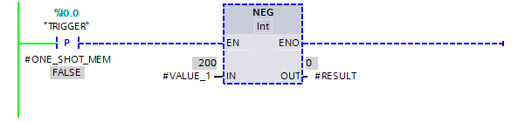
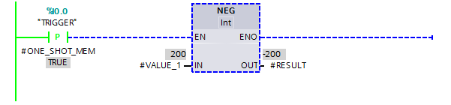
Math
NEGATE

Slide 16
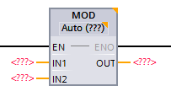
Math
MODULO
When rung conditions are true, the MOD instruction divides IN1 by IN2 and places the remainder in the OUT tag. IN1 and IN2 can either tags that contain values or be constant values, however IN1 and IN2 cannot both be constants. The OUT must be an tag.

Slide 17
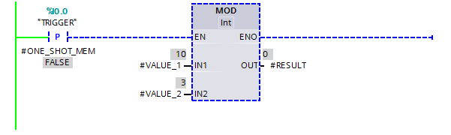
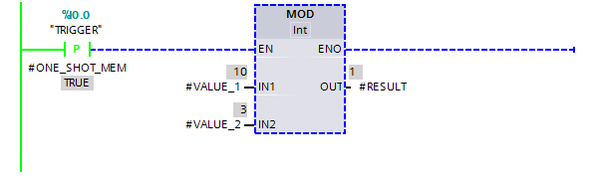
Math
MODULO
In this example, the division of 10 by 3 leaves a remainder of 1.

Slide 18
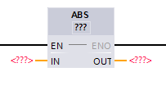
Math
ABSOLUTE
When rung conditions are true, the ABS instruction takes the absolute value of the IN1 and places the result in the OUT. The IN an OUT parameters must be tags.

Slide 19
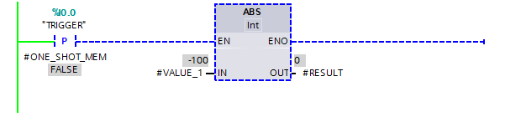

Math
ABSOLUTE

Slide 20
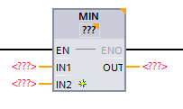
Math
MINIMUM
When rung conditions are true, the MIN instruction takes the IN with the minimum value and places the result in the OUT. The INs and OUT parameters must be tags.

Slide 21
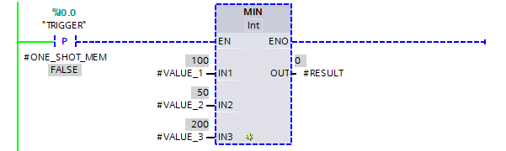
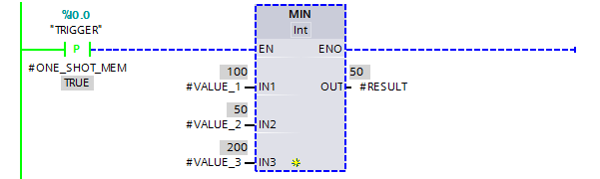
Math
MINIMUM

Slide 22
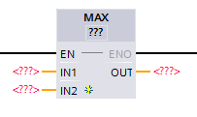
Math
MAXIMUM
When rung conditions are true, the MAX instruction takes the IN with the maximum value and places the result in the OUT. The INs and OUT parameters must be tags.

Slide 23
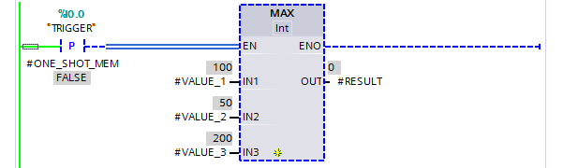
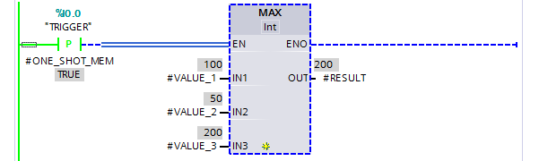
Math
MAXIMUM

Slide 24
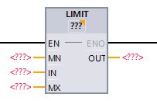
Math
LIMIT
When rung conditions are true, LIMIT instruction to limit the value at input IN to the values at the inputs MN and MX.
If the value at the IN is between or equal to the low limit, MN, or high limit, MX, it places the result in the OUT.
If the IN is below the low limit, MN, the OUT is set to the value of the MN input.
If the IN is above the high limit, MX, the OUT is set to the value of the MX input

Slide 25
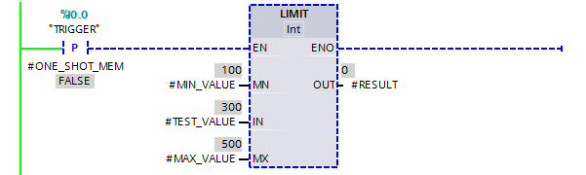
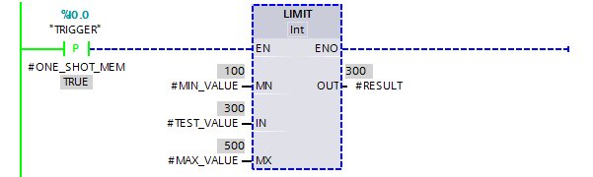
Math
Test value IN is within the Minimum and Maximum values and is placed in the OUT tag.
LIMIT

Slide 26
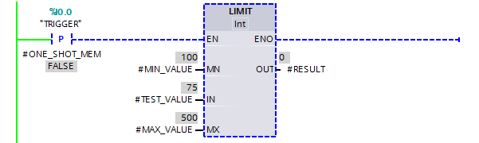

Math
LIMIT
Test value IN is below the Minimum value resulting in the minimum value being placed in the OUT tag.
Test value IN is below the Minimum value… resulting in the minimum value being placed in the OUT tag.

Slide 27


Test value IN is above the Maximum value resulting in the maximum value being placed in the OUT tag.
Math
LIMIT
Test value IN is above the Maximum value… resulting in the minimum value being placed in the OUT tag.

Slide 28
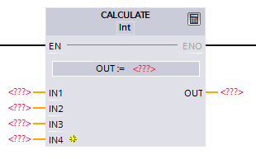
Math
CALCULATE
When rung conditions are true to this output instruction, the operation residing in the Expression field of this instruction is performed and the result is sent to the OUT.
Expressions - The expression uses the values from the INs. Instructions that can be used in the Expression include: +, -, *, / XPY, ASIN, ATAN, COS, TAN, SQR, SQRT, LN, ABS, MOD, TAN.

Slide 29
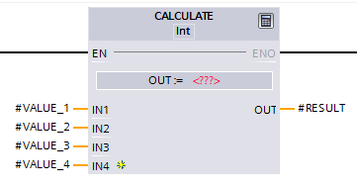
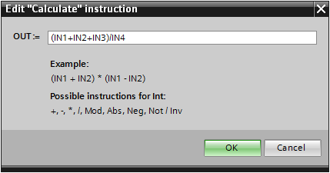
Math
CALCULATE
To enter the expression, select the “calculator” icon.
A dialog opens to enter the IN parameters and operator instructions.

Slide 30
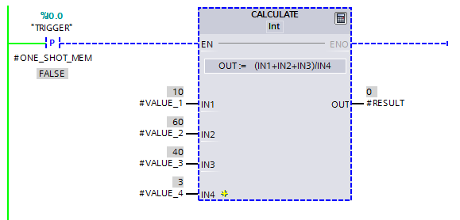
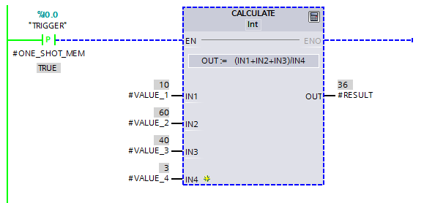
CALCULATE
Math

Slide 31
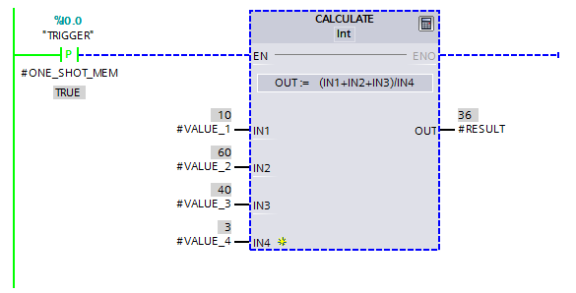
The RESULT of the calculation is 36.67, but the instruction is declared an INT (Integer) Data Type, the result is truncated.
Math
CALCULATE

Slide 32
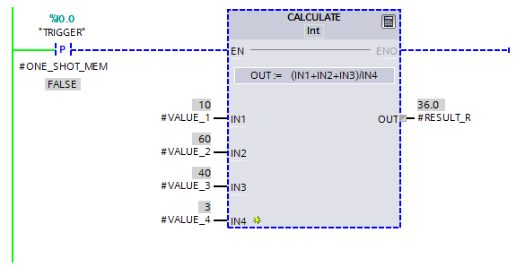
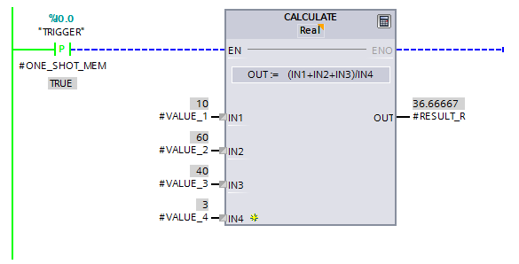
Notice the Implicit Conversion from Integer to Real.
Math
CALCULATE
If the OUT tag of the instruction is defined as a REAL, the result will be truncated due to the instruction declared as an INT (Integer) Data Type.

Slide 33
Math
CALCULATE
Notice the Implicit Conversion from Integer to Real.
An instruction declared as a REAL Data Type and the OUT tag of the instruction is defined as a REAL, the result will produce a REAL.

Slide 34
Other Math Instructions
SQR Calculate the square root of a number
SQRT Calculate the root of a square number
LN Calculate the natural log of a number
SIN Calculate the sine of a number in radians
COS Calculate the cosine of a number in radians
TAN Calculates the tangent of a number in radians
ASIN Calculate the arc sine of a number in radians
ACOS Calculate the arc cosine of a number in radians
ATAN Calculate the arc tangent of a number in radians
FRAC Returns the fraction, the decimal point of a real
XPY Raise a number to the power of a number

Slide 35
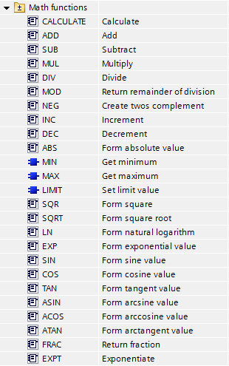
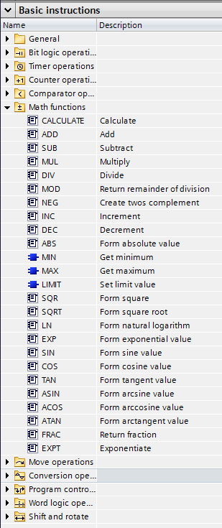
Math
The Math instructions are Basic Instruction in the Math functions folder.

Slide 36
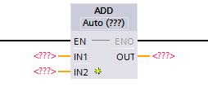
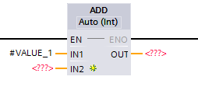
Implicit Data Type
When an instruction is added…
…the instruction’s Data Type is assumed from the IN1 Tag’s Data Type.
In this example, an Integer (Int) Data Type.

Slide 37
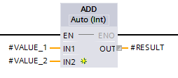
Implicit Data Type
Notice in the OUT, the Tag RESULT is a REAL Data Type and the Implicit Conversion to an Integer data type is performed.
Note: The RESULT tag remain a REAL Data Type, the conversion is for the instruction only.

Slide 38
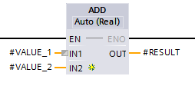
Implicit Data Type
If an IN is a REAL Data Type, then the Instruction changes to a REAL usage.
In this example, the VALUE_2 Tag is a REAL Data Type.
The Tag VALUE_1 is an INTEGER Data Type and the Implicit Conversion to a REAL is performed.

Slide 39
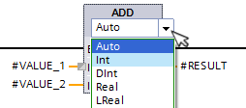
Implicit Data Type
The Dropdown for the instruction may be selected to specify the native Data Type for the instruction.
Note: There are some Data Type that cannot use the Implicit Conversion.
The instruction’s Data Type then must be set for that Data Type. Limitation, other data type used must support Implicit Conversion.
Note: Not all Data Types are supported by all Instructions.

